Slide 1
JavaScript: Client-Side Scripting
Chapter 6

Slide 2
Objectives
1
2
What is JavaScript
JavaScript Design
3
4
Using
JavaScript
Syntax
5
6
JavaScript
Objects
The DOM
7
7
JavaScript
Events
8
Forms

Slide 3
What IS Javascript
Section 1 of 8

Slide 4
What is JavaScript
.runs right inside the browser
is dynamically typed
Is object oriented in that almost everything in the language is an object
the objects in JavaScript are prototype-based rather than class-based.

Slide 5
Advantages of Client-Side Scripting
It’s good
Processing can be offloaded from the server to client machines, thereby reducing the load on the server.
The browser can respond more rapidly to user events.
JavaScript can interact with the downloaded HTML in a way that the server cannot, creating a user experience more like desktop software than simple HTML ever could.

Slide 6
Disadvantages Client-Side Scripting
There are challenges
There is no guarantee that the client has JavaScript enabled
What works in one browser, may generate an error in another.
JavaScript-heavy web applications can be complicated to debug and maintain.

Slide 7
JavaScript History
JavaScript was introduced by Netscape in their Navigator browser back in 1996.
JavaScript is in fact an implementation of a standardized scripting language called ECMAScript
JavaScript was only slightly useful, and quite often, very annoying tomany users

Slide 8
JavaScript in Modern Times
AJAX
JavaScript became a much more important part of web development in the mid 2000s with AJAX.
AJAX is both an acronym as well as a general term.
As an acronym it means Asynchronous JavaScript And XML.
The most important feature of AJAX sites is the asynchronous data requests.

Slide 9
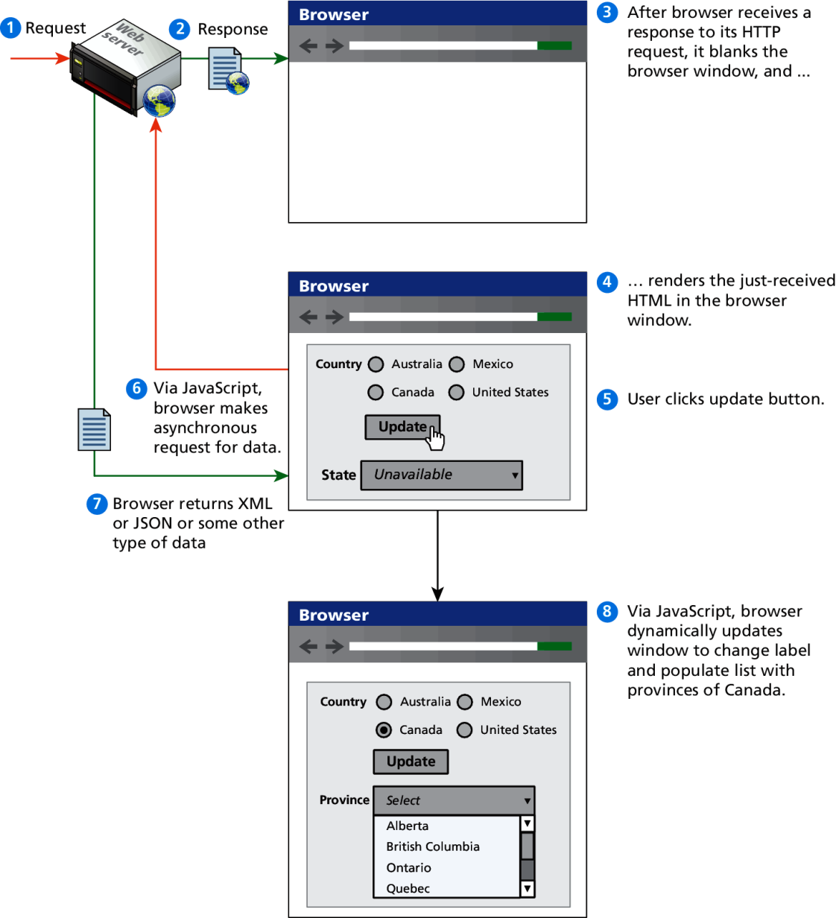
Asynchronous data requests
The better AJAX way

Slide 10
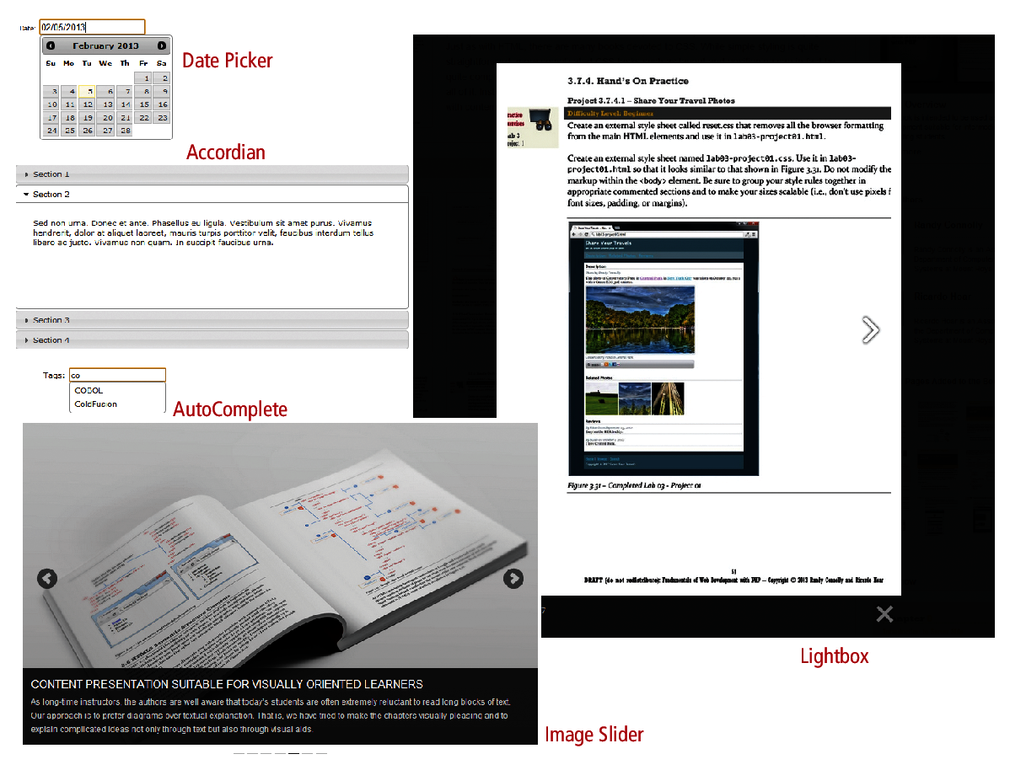
Frameworks
Lots of this is done for you, once you get the basics

Slide 11
Javascript Design Principles
Section 2 of 8

Slide 12
Layers
They help organize
Abstract the solution to build a cognitive model in your mind that you can then implement.
In object-oriented programming, a software layer is a way of conceptually grouping programming classes that have similar functionality and dependencies.

Slide 13
Layers
Common Layers
Presentation layer. Classes focused on the user interface.
Business layer. Classes that model real-world entities, such as customers, products, and sales.
Data layer. Classes that handle the interaction with the data sources.

Slide 14
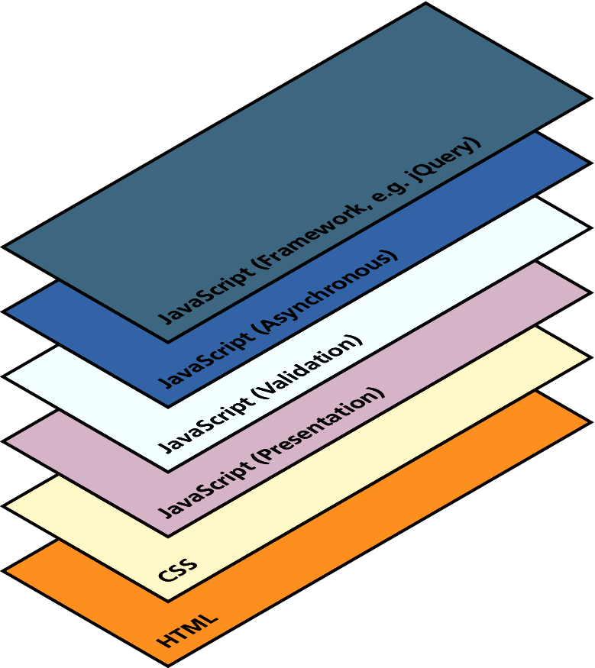
Layers
Just a conceptual idea

Slide 15
Users Without Javascript
They do exist
Web crawler. A web crawler is a client running on behalf of a search engine to download your site, so that it can eventually be featured in their search results.
Browser plug-in. A browser plug-in is a piece of software that works within the browser, that might interfere with JavaScript.
Text-based client. Some clients are using a text-based browser.
Visually disabled client. A visually disabled client will use special web browsing software to read the contents of a web page out loud to them.

Slide 16
The <noscript> tag
Mechanism to speak to those with JavaScript
Any text between the opening and closing tags will only be displayed to users without the ability to load JavaScript.
It is often used to prompt users to enable JavaScript, but can also be used to show additional text to search engines.
Requiring JavaScript (or Flash) for the basic operation of your site will cause problems eventually and should be avoided.

Slide 17
Graceful Degradation and Progressive Enhancement
Over the years, browser support for different JavaScript objects has varied. Something that works in the current version of Chrome might not work in IE version 8; something that works in a desktop browser might not work in a mobile browser.
There are two strategies:
graceful degradation
progressive enhancement

Slide 18
Graceful Degradation
Used in current browsers.
For all others an alternate site or pages for those using older browsers that lack the JavaScript (or CSS or HTML5) used on the main site.
The idea here is that the site is “degraded” (i.e., loses capability) “gracefully” (i.e., without pop-up JavaScript error codes or without condescending messages telling users to upgrade their browsers)

Slide 19
Graceful Degradation

Slide 20
Progressive Enhancement
In this case, the developer creates the site using CSS, JavaScript, and HTML features that are supported by all browsers of a certain age or newer.
To that baseline site, the developers can now “progressively” (i.e., for each browser) “enhance” (i.e., add functionality) to their site based on the capabilities of the users’ browsers.

Slide 21
Progressive Enhancement

Slide 22
Where Does Javascript GO?
Section 3 of 8

Slide 23
Where does JavaScript go?
JavaScript can be linked to an HTML page in a number of ways.
Inline
Embedded
External

Slide 24
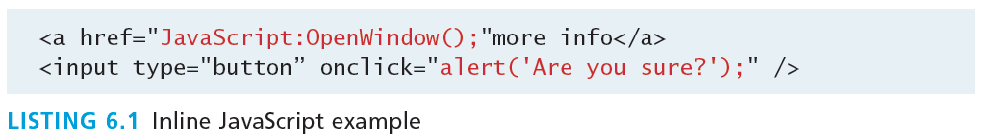
Inline JavaScript
Mash it in
Inline JavaScript refers to the practice of including JavaScript code directly within certain HTML attributes
Inline JavaScript is a real maintenance nightmare

Slide 25
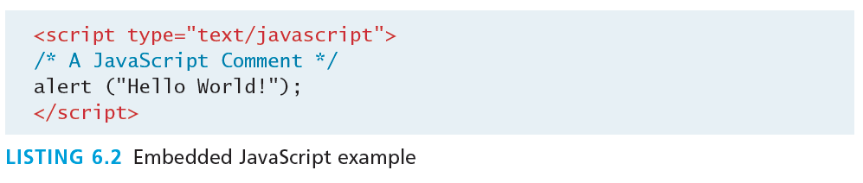
Embedded JavaScript
Better
Embedded JavaScript refers to the practice of placing JavaScript code within a <script> element

Slide 26
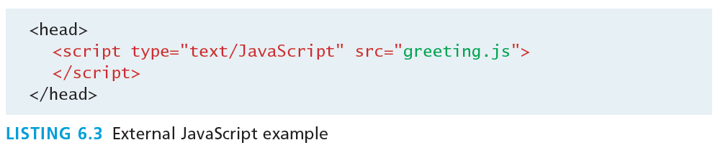
External JavaScript
Better
JavaScript supports this separation by allowing links to an external file that contains the JavaScript.
By convention, JavaScript external files have the extension .js.

Slide 27
Advanced Inclusion
In production sites, advanced techniques are used
Generate embedded styles to reduce requests
Code still managed in a external file
<iframe> loading
Asynchronus load from another JavaScript file
Faster initial load

Slide 28
Syntax
Section 4 of 8

Slide 29
JavaScript Syntax
We will briefly cover the fundamental syntax for the most common programming constructs including
variables,
assignment,
conditionals,
loops, and
arrays
before moving on to advanced topics such as events and classes.

Slide 30
JavaScript’s Reputation
Precedes it?
JavaScript’s reputation for being quirky not only stems from its strange way of implementing object-oriented principles but also from some odd syntactic gotchas:
Everything is type sensitive, including function, class, and variable names.
The scope of variables in blocks is not supported. This means variables declared inside a loop may be accessible outside of the loop, counter to what one would expect.
There is a === operator, which tests not only for equality but type equivalence.
Null and undefined are two distinctly different states for a variable.
Semicolons are not required, but are permitted (and encouraged).
There is no integer type, only number, which means floating-point rounding errors are prevalent even with values intended to be integers.
Read this: https://stackoverflow.com/questions/2800964/benefits-of-prototypal-inheritance-over-classical/16872315#16872315

Slide 31
Variables
var
Variables in JavaScript are dynamically typed, meaning a variable can be an integer, and then later a string, then later an object, if so desired.
This simplifies variable declarations, so that we do not require the familiar type fields like int, char, and String. Instead we use var
Assignment can happen at declaration-time by appending the value to the declaration, or at run time with a simple right-to-left assignment

Slide 32
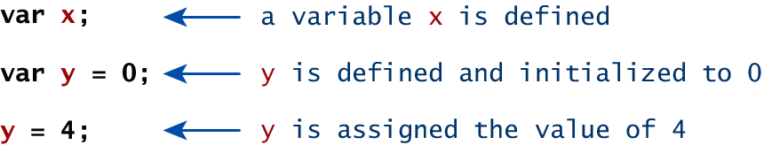
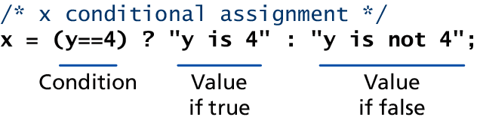
Variables
Assignment

Slide 33
Comparison Operators
True or not True
Operator | Description | Matches (x=9)
== | Equals | (x==9) is true (x=="9") is true
=== | Exactly equals, including type | (x==="9") is false (x===9) is true
< , > | Less than, Greater Than | (x<5) is false
<= , >= | Less than or equal, greater than or equal | (x<=9) is true
!= | Not equal | (4!=x) is true
!== | Not equal in either value or type | (x!=="9") is true (x!==9) is false

Slide 34
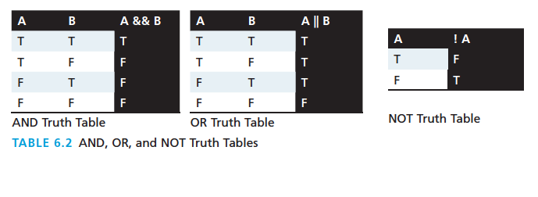
Logical Operators
The Boolean operators and, or, and not and their truth tables are listed in Table 6.2. Syntactically they are represented with && (and), || (or), and ! (not).

Slide 35
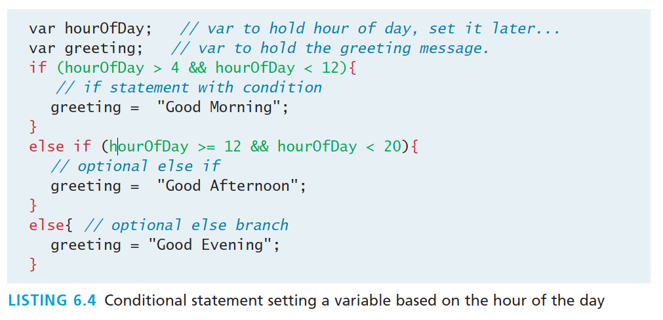
Conditionals
If, else if, …, else
JavaScript’s syntax is almost identical to that of PHP, Java, or C when it comes to conditional structures such as if and if else statements. In this syntax the condition to test is contained within ( ) brackets with the body contained in { } blocks.

Slide 36
Loops
Round and round we go
Like conditionals, loops use the ( ) and { } blocks to define the condition and the body of the loop.
You will encounter the while and for loops
While loops normally initialize a loop control variable before the loop, use it in the condition, and modify it within the loop.
var i=0; // initialise the Loop Control Variable
while(i < 10){ //test the loop control variable
i++; //increment the loop control variable
}

Slide 37
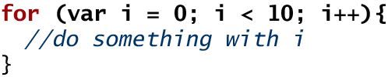
For Loops
Counted loops
A for loop combines the common components of a loop: initialization, condition, and post-loop operation into one statement.
This statement begins with the for keyword and has the components placed between ( ) brackets, semicolon (;) separated as shown

Slide 38
Functions
Building block for modular code.
Functions do not require a return type, nor do the parameters require type.

Slide 39
Functions
Example
Therefore a function to raise x to the yth power might be defined as:
function power(x,y){
var pow=1;
for (var i=0;i<y;i++){
pow = pow*x;
}
return pow;
}
And called as
power(2,10);

Slide 40
Alert
Not really used anymore, console instead
alert ( "Good Morning" );
Using alerts can get tedious fast. When using debugger tools in your browser you can write output to a log with:
console.log("Put Messages Here");
And then use the debugger to access those logs.

Slide 41
Javascript Objects
Section 5 of 8

Slide 42
JavaScript Objects
Objects not Classes
JavaScript is not a full-fledged object-oriented programming language.
Support objects but does not have polymorphism, inheritance.

Slide 43
JavaScript Objects
Not full-fledged O.O.
Objects can have constructors, properties, and methods associated with them.
There are objects that are included in the JavaScript language; you can also define your own kind of objects.

Slide 44
Constructors
Create a new object, use new keyword, the class name, and ( ) brackets with n optional parameters inside, comma delimited as follows:
var someObject = new ObjectName(p1,p2,..., pn);
For some classes, shortcut constructors are defined
var greeting = "Good Morning";
vs the formal:
var greeting = new String("Good Morning");

Slide 45
Properties
Use the dot
Each object might have properties that can be accessed, depending on its definition.
When a property exists, it can be accessed using dot notation where a dot between the instance name and the property references that property.
//show someObject.property to the user alert(someObject.property);

Slide 46
Methods
Use the dot, with brackets
Use .
someObject.doSomething();

Slide 47
Objects Included in JavaScript
A number of useful objects are included with JavaScript including:
Array
Boolean
Date
Math
String
Dom objects

Slide 48
Arrays
The following code creates a new, empty array named greetings:
var greetings = new Array();

Slide 49
Arrays
Initialize with values
To initialize the array with values, the variable declaration would look like the following:
var greetings = new Array("Good Morning", "Good Afternoon");
or, using the square bracket notation:
var greetings = ["Good Morning", "Good Afternoon"];

Slide 50
Arrays
Access and Traverse
alert ( greetings[0] );
Transversing an array.
for (var i = 0; i < greetings.length; i++){
alert(greetings[i]);
}

Slide 51
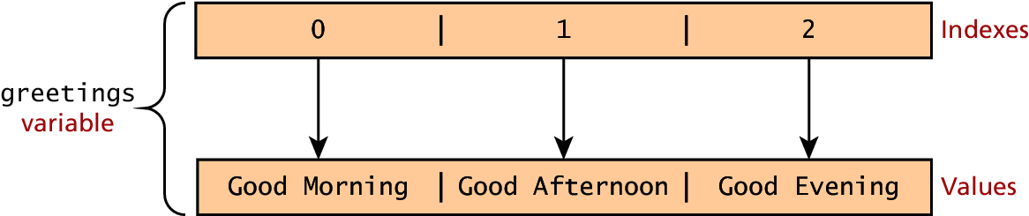
Arrays
Index and Value

Slide 52
Arrays
Modifying an array
To add an item to an existing array, you can use the push method.
greetings.push("Good Evening");
The pop method can be used to remove an item from the back of an array.
Additional methods: concat(), slice(), join(), reverse(), shift(), and sort()

Slide 53
Math
The Math class allows one to access common mathematic functions and common values quickly in one place.
Methods max(), min(), pow(), sqrt(), and exp(), sin(), cos(), and arctan().
Many mathematical constants are defined such as PI, E, SQRT2, and some others
Math.PI; // 3.141592657
Math.sqrt(4); // square root of 4 is 2.
Math.random(); // random number between 0 and 1

Slide 54
String
The String class has already been used without us even knowing it.
Constructor usage
var greet = new String("Good"); // long form constructor
var greet = "Good"; // shortcut constructor
Length of a string
alert (greet.length); // will display "4"

Slide 55
String
Concatenation and so much more
var str = greet.concat("Morning"); // Long form concatenation
var str = greet + "Morning"; // + operator concatenation
Many other useful methods exist within the String class, such as
accessing a single character using charAt()
searching for one using indexOf().
Strings allow splitting a string into an array, searching and matching with split(), search(), and match() methods.

Slide 56
Date
Not that kind
Use it to show the current date or create date objects for particular dates.
To display today’s date as a string,Create a new object and use the toString() method.
var d = new Date();
// This outputs Today is Mon Nov 12 2012 15:40:19 GMT-0700
alert ("Today is "+ d.toString());

Slide 57
The Document Object Model (DOM)
Section 6 of 8

Slide 58
The DOM
Document Object Model
JavaScript is almost always used to interact with the HTML document in which it is contained.
This is accomplished through a programming interface (API) called the Document Object Model.
According to the W3C, the DOM is a:
Platform- and language-neutral interface that will allow programs and scripts to dynamically access and update the content, structure and style of documents.

Slide 59
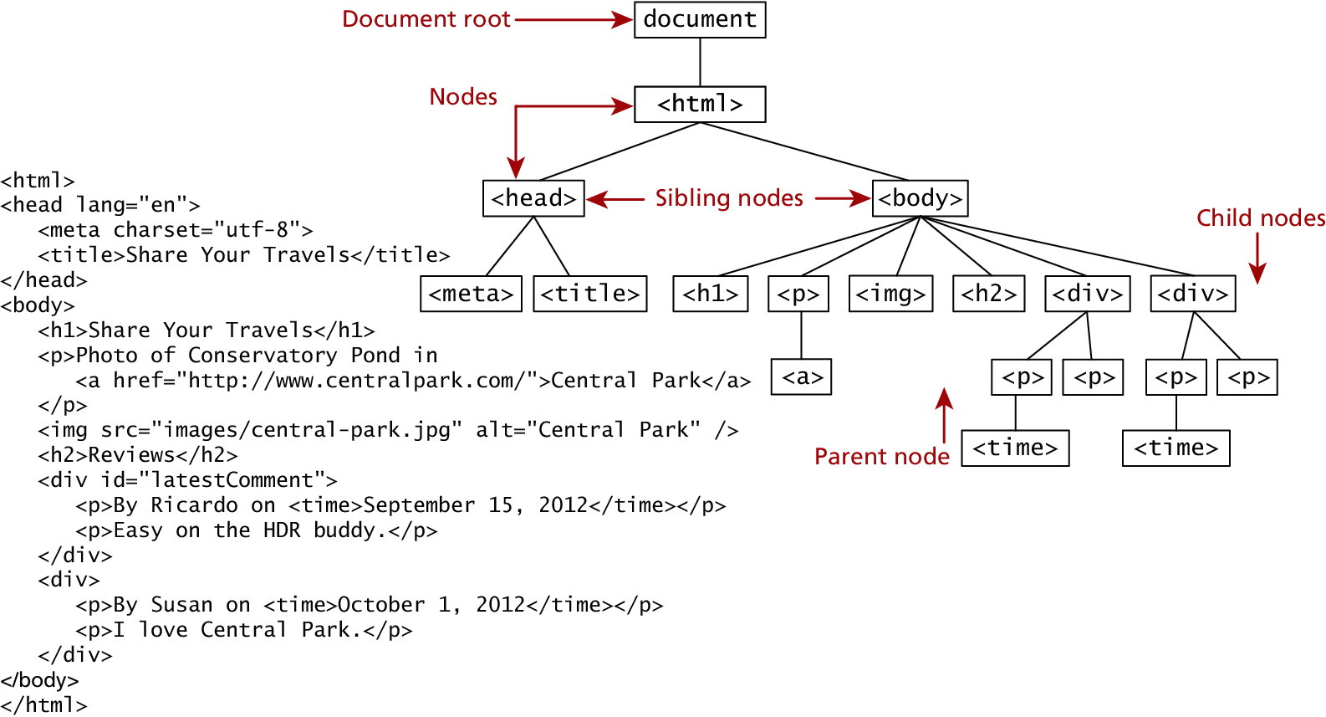
The DOM
Seems familiar, because it is!
We already know all about the DOM, but by another name.
(HTML) is formally called the DOM Tree with the root, or topmost object called the Document Root.

Slide 60
DOM Nodes
In the DOM, each element within the HTML document is called a node. If the DOM is a tree, then each node is an individual branch.
There are:
element nodes,
text nodes, and
attribute nodes
All nodes in the DOM share a common set of properties and methods.

Slide 61
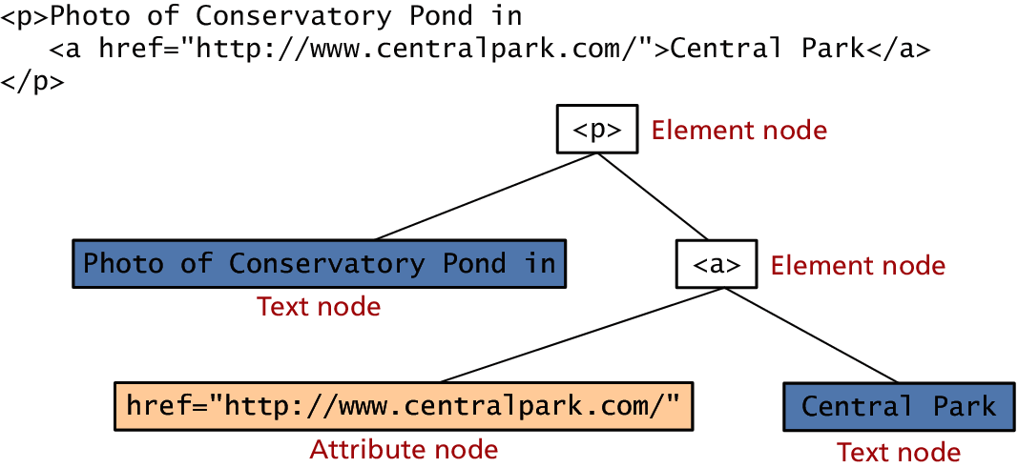
DOM Nodes
Element, text and attribute nodes

Slide 62
DOM Nodes
Essential Node Object properties
Property | Description
attributes | Collection of node attributes
childNodes | A NodeList of child nodes for this node
firstChild | First child node of this node.
lastChild | Last child of this node.
nextSibling | Next sibling node for this node.
nodeName | Name of the node
nodeType | Type of the node
nodeValue | Value of the node
parentNode | Parent node for this node.
previousSibling | Previous sibling node for this node.

Slide 63
Document Object
One root to ground them all
The DOM document object is the root JavaScript object representing the entire HTML document.
It contains some properties and methods that we will use extensively in our development and is globally accessible as document.
// specify the doctype, for example html
var a = document.doctype.name;
// specify the page encoding, for example ISO-8859-1
var b = document.inputEncoding;

Slide 64
Document Object
Document Object Methods
Method | Description
createAttribute() | Creates an attribute node
createElement() | Creates an element node
createTextNode() | Create a text node
getElementById(id) | Returns the element node whose id attribute matches the passed id parameter.
getElementsByTagName(name) | Returns a nodeList of elements whose tag name matches the passed name parameter.

Slide 65
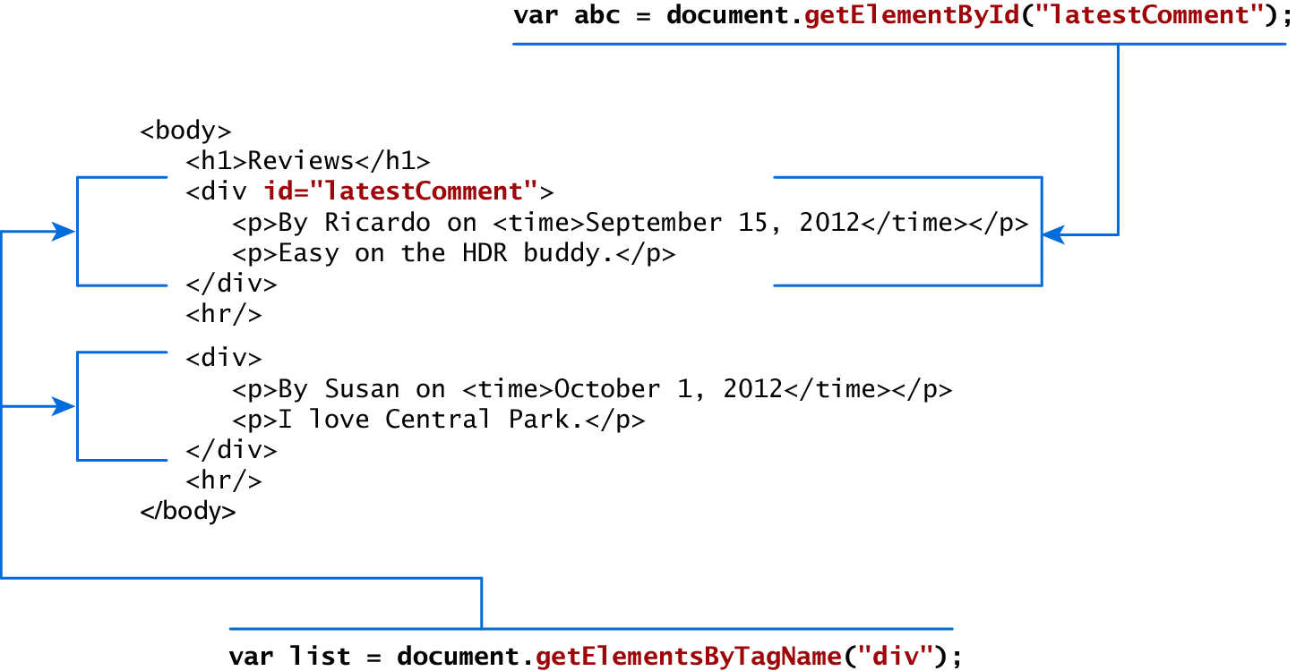
Accessing nodes
getElementById(), getElementsByTagName()

Slide 66
Element node Object
document.getElementById() returns an element node object.
This represents an HTML element in the hierarchy, contained between the opening <> and closing </> tags for this element.
can itself contain more elements

Slide 67
Element node Object
Essential Element Node Properties
Property | Description
className | The current value for the class attribute of this HTML element.
id | The current value for the id of this element.
innerHTML | Represents all the things inside of the tags. This can be read or written to and is the primary way which we update particular div's using JS.
style | The style attribute of an element. We can read and modify this property.
tagName | The tag name for the element.

Slide 68
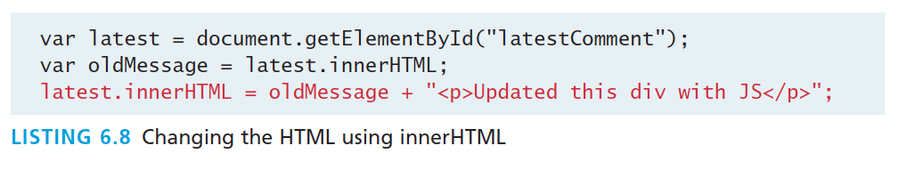
Modifying a DOM element
The document.write() method is used to create output to the HTML page from JavaScript.
Using the DOM document and HTML DOM element objects, we can do exactly that using the innerHTML property

Slide 69
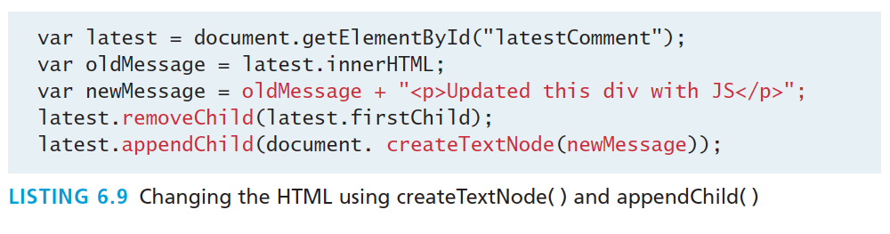
Modifying a DOM element
DOM functions createTextNode(), removeChild(), and appendChild() allow us to modify an .

Slide 70
Changing an element’s style
We can add or remove any style using the style or className property of the Element node.
Its usage is shown below to change a node’s background color and add a three-pixel border.
var commentTag = document.getElementById("specificTag");
commentTag.style.backgroundColour = "#FFFF00";
commentTag.style.borderWidth="3px";

Slide 71
Changing an element’s style
With class
The className property is normally a better choice, because it allows the styles to be created outside the code, and thus be better accessible to designers.
var commentTag = document.getElementById("specificTag");
commentTag.className = "someClassName";
HTML5 introduces the classList element, which allows you to add, remove, or toggle a CSS class on an element.
label.classList.addClass("someClassName");

Slide 72
More Properties
<!DOCTYPE html>
<html>
<body>
<p>
<a href="/html/default.asp">HTML</a>
<br>
<a href="/css/default.asp">CSS</a>
</p>
<p id="demo"></p>
<script>
document.getElementById("demo").innerHTML =
"The href of the first link is " + document.links[0].href;
</script>
</body>
</html>
Some Specific HTML DOM Element Properties for Certain Tag Types
Property | Description | Tags
href | The href attribute used in a tags to specify a URL to link to. | a
name | The name property is a bookmark to identify this tag. Unlike id which is available to all tags, name is limited to certain form related tags. | a, input, textarea, form
src | Links to an external URL that should be loaded into the page (as opposed to href which is a link to follow when clicked) | img, input, iframe, script
value | The value is related tot he value attribute of input tags. Often the value of an input field is user defined, and we use value to get that user input. | Input, textarea, submit

Slide 73
More Properties
<!DOCTYPE html>
<html>
<body>
<h2 class="example">A heading with class="example"</h2>
<p class="example">A paragraph with class="example".</p>
<p>Click the button to add a background color to the first element in the document with class="example" (index 0).</p>
<button onclick="myFunction()">Try it</button>
<p><strong>Note:</strong> The querySelectorAll() method is not supported in Internet Explorer 8 and earlier versions.</p>
<script>function myFunction() {
var x = document.querySelectorAll(".example");
x[0].style.backgroundColor = "red";
}</script>
</body>
</html>

Slide 74
JavaScript Events
Section 7 of 8

Slide 75
JavaScript Events
A JavaScript event is an action that can be detected by JavaScript.
We say then that an event is triggered and then it can be caught by JavaScript functions, which then do something in response.

Slide 76
JavaScript Events
A brave new world
In the original JavaScript world, events could be specified right in the HTML markup with hooks to the JavaScript code (and still can).
As more powerful frameworks were developed, and website design and best practices were refined, this original mechanism was supplanted by the listener approach.

Slide 77
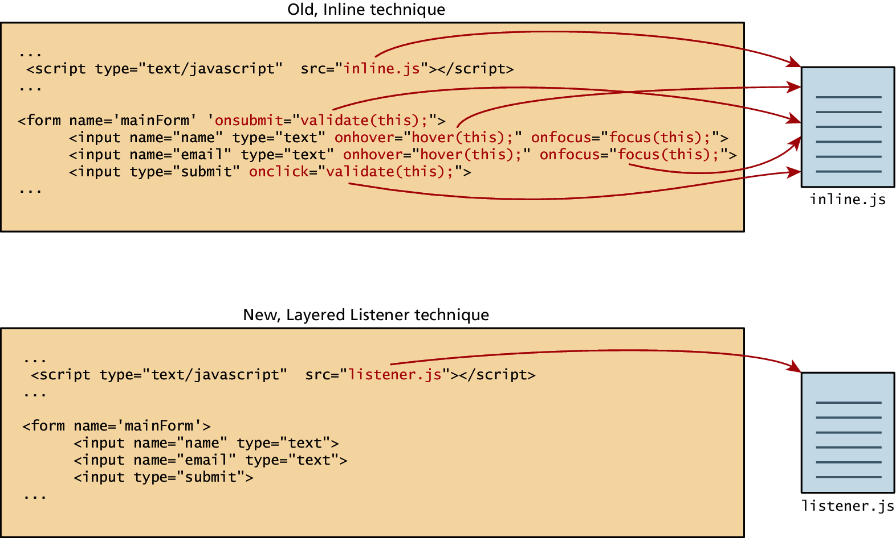
JavaScript Events
Two approaches

Slide 78
Inline Event Handler Approach
For example, if you wanted an alert to pop-up when clicking a <div> you might program:
<div id="example1" onclick="alert('hello')">Click for pop-up</div>

Slide 79
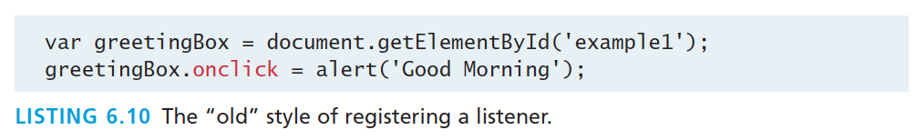
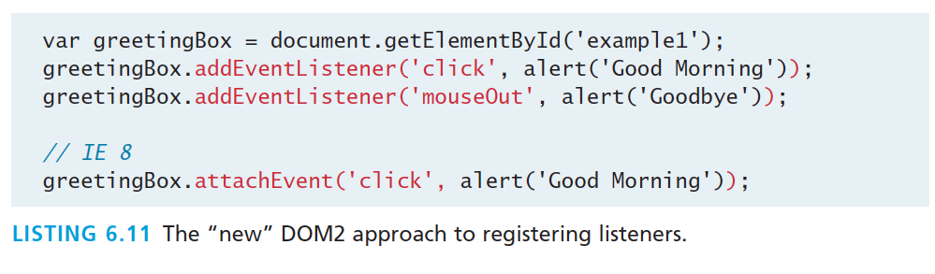
Listener Approach
Two ways to set up listeners

Slide 80
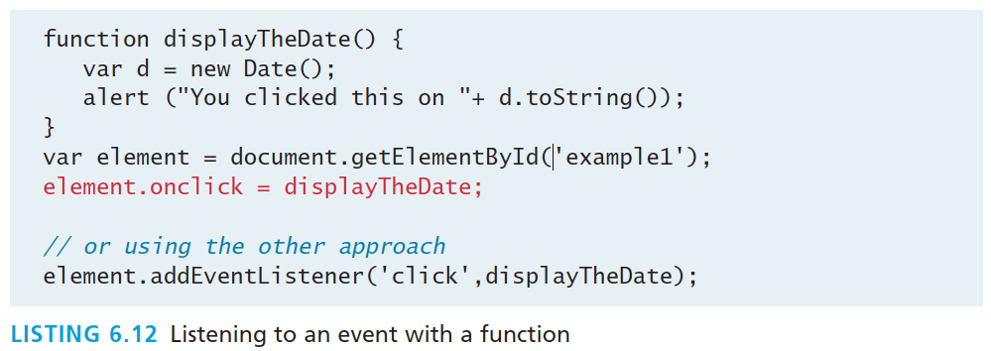
Listener Approach
Using functions
What if we wanted to do something more elaborate when an event is triggered? In such a case, the behavior would have to be encapsulated within a function, as shown in Listing 6.12.

Slide 81
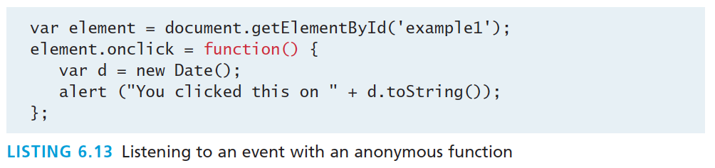
Listener Approach
Anonymous functions
An alternative to that shown in Listing 6.12 is to use an anonymous function (that is, one without a name), as shown in Listing 6.13.

Slide 82
Event Object
No matter which type of event we encounter, they are all DOM event objects and the event handlers associated with them can access and manipulate them. Typically we see the events passed to the function handler as a parameter named e.
function someHandler(e) {
// e is the event that triggered this handler.
}

Slide 83
Event Object
Several Options
Bubbles. If an event’s bubbles property is set to true then there must be an event handler in place to handle the event or it will bubble up to its parent and trigger an event handler there.
Cancelable. The Cancelable property is also a Boolean value that indicates whether or not the event can be cancelled.
preventDefault. A cancelable default action for an event can be stopped using the preventDefault() method in the next slide

Slide 84
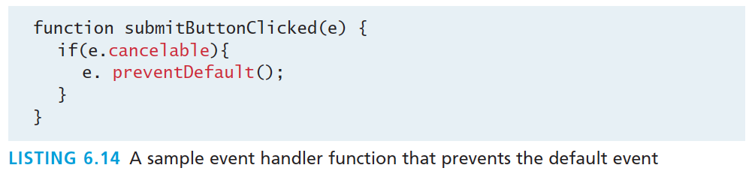
Event Object
Prevent the default behaviour

Slide 85
Event Types
There are several classes of event, with several types of event within each class specified by the W3C:
mouse events
keyboard events
form events
frame events

Slide 86
Mouse events
Event | Description
onclick | The mouse was clicked on an element
ondblclick | The mouse was double clicked on an element
onmousedown | The mouse was pressed down over an element
onmouseup | The mouse was released over an element
onmouseover | The mouse was moved (not clicked) over an element
onmouseout | The mouse was moved off of an element
onmousemove | The mouse was moved while over an element

Slide 87
Keyboard events
Event | Description
onkeydown | The user is pressing a key (this happens first)
onkeypress | The user presses a key (this happens after onkeydown)
onkeyup | The user releases a key that was down (this happens last)

Slide 88
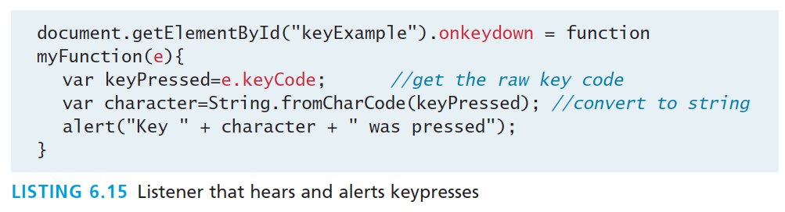
Keyboard events
Example
<input type="text" id="keyExample">
The input box above, for example, could be listened to and each key pressed echoed back to the user as an alert as shown in Listing 6.15.

Slide 89
Form Events
Event | Description
onblur | A form element has lost focus (that is, control has moved to a different element, perhaps due to a click or Tab key press.
onchange | Some <input>, <textarea> or <select> field had their value change. This could mean the user typed something, or selected a new choice.
onfocus | Complementing the onblur event, this is triggered when an element gets focus (the user clicks in the field or tabs to it)
onreset | HTML forms have the ability to be reset. This event is triggered when that happens.
onselect | When the users selects some text. This is often used to try and prevent copy/paste.
onsubmit | When the form is submitted this event is triggered. We can do some pre-validation when the user submits the form in JavaScript before sending the data on to the server.

Slide 90
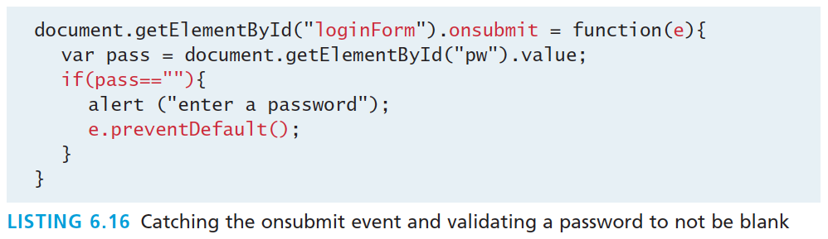
Form Events
Example

Slide 91
Frame Events
Frame events are the events related to the browser frame that contains your web page.
The most important event is the onload event, which tells us an object is loaded and therefore ready to work with. If the code attempts to set up a listener on this not-yet-loaded <div>, then an error will be triggered.
window.onload= function(){
//all JavaScript initialization here.
}

Slide 92
Frame Events
Table of frame events
Event | Description
onabort | An object was stopped from loading
onerror | An object or image did not properly load
onload | When a document or object has been loaded
onresize | The document view was resized
onscroll | The document view was scrolled
onunload | The document has unloaded

Slide 93
Forms
Section 8 of 8

Slide 94
Validating Forms
You mean pre-validating right?
Writing code to prevalidate forms on the client side will reduce the number of incorrect submissions, thereby reducing server load.
There are a number of common validation activities including email validation, number validation, and data validation.

Slide 95
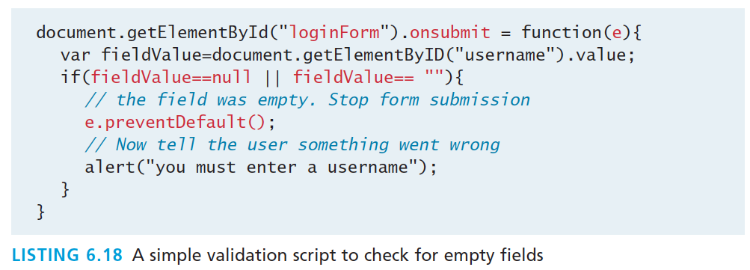
Validating Forms
Empty field

Slide 96
Validating Forms
Empty field
If you want to ensure a checkbox is ticked, use code like that below.
var inputField=document.getElementByID("license");
if (inputField.type=="checkbox"){
if (inputField.checked)
//Now we know the box is checked
}

Slide 97
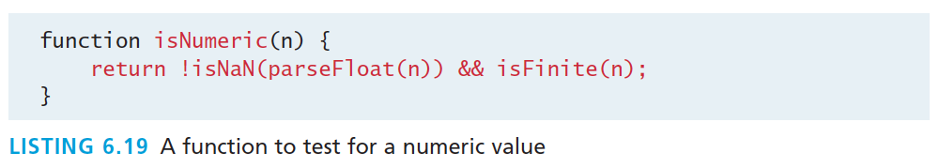
Validating Forms
Number Validation

Slide 98
Validating Forms
More to come in Chapter 12
Form validation uses regular expressions, covered in Chapter 12

Slide 99
Submitting Forms
Submitting a form using JavaScript requires having a node variable for the form element. Once the variable, say, formExample is acquired, one can simply call the submit() method:
var formExample = document.getElementById("loginForm");
formExample.submit();
This is often done in conjunction with calling preventDefault() on the onsubmit event.

Slide 100
What you Learned
1
2
What is JavaScript
JavaScript Design
3
4
Using
JavaScript
Syntax
5
6
JavaScript
Objects
The DOM
7
7
JavaScript
Events
8
Forms

